Slide 1

FSH_Presentation

Slide 2


Finding and sharing house for lease
Supervisor: Mr. Tran Binh Duong
Students:
Nguyen Duc Thuong
Duong Hong Loc
Chu Minh Tung
Pham Van Khanh
Pham Tuan Anh

Slide 3



Contents
1. Introduction
2. Project Management
3. Requirement Specifications
4. Design Description
5. Test Documentation
6. Summary
7. Demo & Q&A
FSH

Slide 4
Part 1: Introduction
1
The People
2
Background
3
Literature Review
3
4
Our Proposal &Products
4
FSH

Slide 5
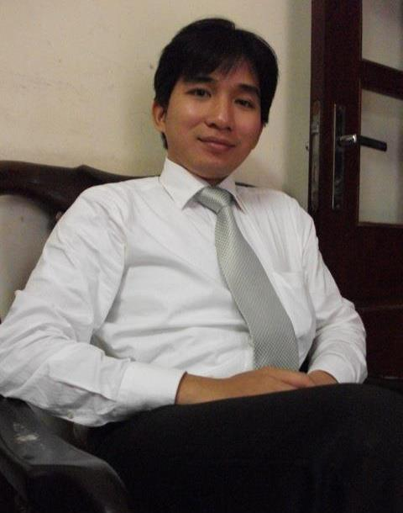
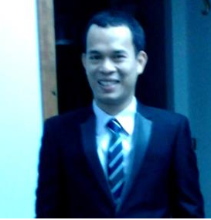
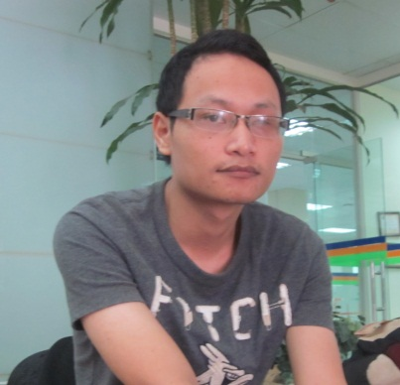
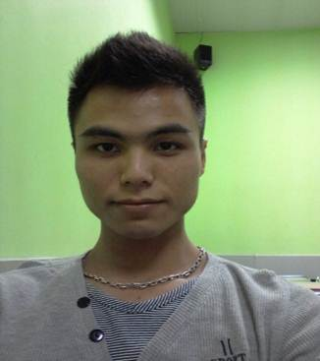

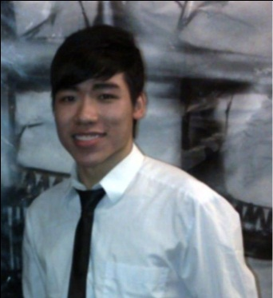
Part 1: Introduction
1
The People
Mr. Tran Binh Duong
Supervisor
Chu Minh Tung
Technical Leader
Nguyen Duc Thuong
Project Manager
Pham Van Khanh
Tester Leader
Duong Hong Loc
Quality Assurance
Pham Tuan Anh
Designer
FSH

Slide 6
Part 1: Introduction
2
Background
Student in Ha Noi : 690,276 (2011)
http://www.gso.gov.vn
The need of finding and sharing house for lease is very popular.
Students spend lots of time for asking friends or going to somewhere to find a suitable house for lease.
Sometime, you want to share your house, or introduce for someone about house for lease, but you do not know how to share
FSH

Slide 7

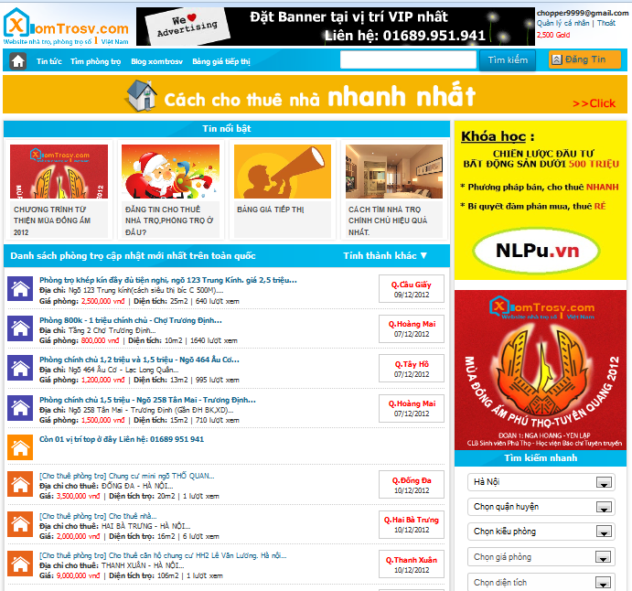
Part 1: Introduction
Literature Review
3
This site supports good find house for lease. But there are some functions do not support users as:
The website has not function compare between many topics together.
This site have support Google map but does not support the display of the surrounding services such as bus stations, universities, markets, parks.
Not support user can rate others the topics, favorite list.
FSH

Slide 8

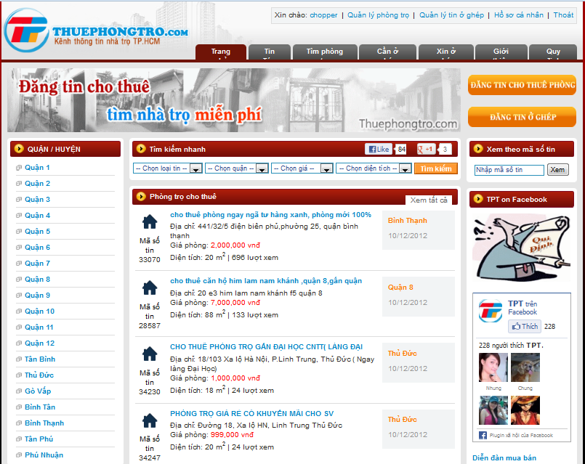
Part 1: Introduction
Literature Review
3
This site is only supported in Ho Chi Minh City.
This website does not support location in Google map.
The website has not function compare between many topics together.
Not support user can rate others the topics, favorite list.
FSH

Slide 9
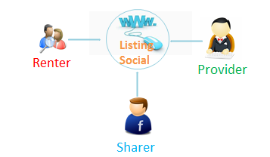
Part 1: Introduction
Our Proposal & Products
4
Web application for finding and sharing house for lease.
Our website will help people to find and share house for lease easily and efficiently.
FSH

Slide 10
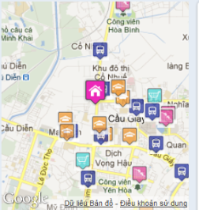



Part 1: Introduction
Our Proposal & Products
4
Advantages
Only information about house for lease
Compare
Favorite
Fan Pages
Support Google map
FSH

Slide 11
Part 2: Software Project Management
1
Development Environment
2
Process
3
Project Planning
3
FSH

Slide 12


Part 2: Software Project Management
1
Development Environment
Development Hardware
2 Gb of RAM,
50 Gb of hard disk
Pentium dual core 2.0 GHz.
Server Hardware
2 Gb of RAM
50Gb of hard disk
Core 2 Duo 2.0 GHz
FSH

Slide 13









Part 2: Software Project Management
1
Development Environment
Framework :
Environment :
Web Server:
Source Control:
Operating system:
DBMS:
API:
FSH

Slide 14
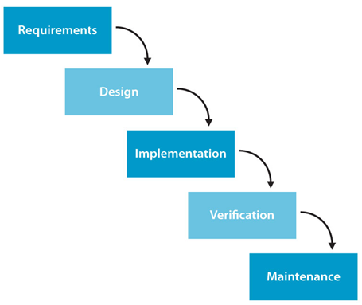
Part 2: Software Project Management
2
Process
Follow Waterfall model
FSH

Slide 15
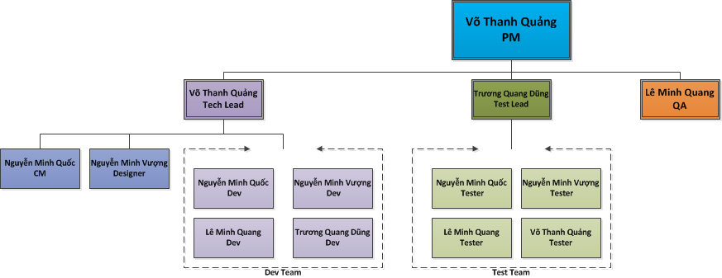
Project Organization

Slide 16
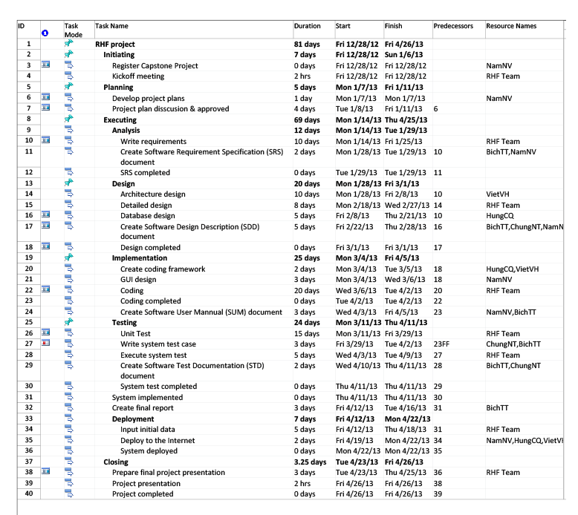
Part 2: Software Project Management
3
Project Planning
3
FSH

Slide 17
Part 3: System Requirement Specifications
User Requirements
System Requirements
Non-functional requirements*

Slide 18


User requirements
Visitor
User
Administration

Slide 19
User Requirements – Visitor
Create a new account
Search for post
Create ,edit , renew & delete post
View post
View, upload images, share .. posts

Slide 20
User Requirements –Users
Login Log out
Change User profile
Reset , Change password
Manage Post, Payment, Favorite
Add , remove Favorite post
Report post
Use All Function of Visitor

Slide 21

User Requirements – Admin
Manage Categories
Manage Reports post
Manage Posts
Manage Bad Post
Manage Provinces
Manage Districts
Manage Locations
Manage Post Status
Manage Roles
Manage Payment
Manage Bad Words
Manage Bad Word Types
Manage Config
Use all functions in the system

Slide 22
Part 3: System Requirement Specifications
Functional Requirements
System
Auto hide the post after 30 days posted
Auto send sms to user to notification
about the topic had Expire
FSH

Slide 23
Part 3: System Requirement Specifications
Non-functional requirements
Reliability
Availability
Security
Maintainability
Portability
Performance
FSH

Slide 24
Part 4: Software Design Description
1
Architectural design
2
Detailed design
3
Database design
3
FSH

Slide 25
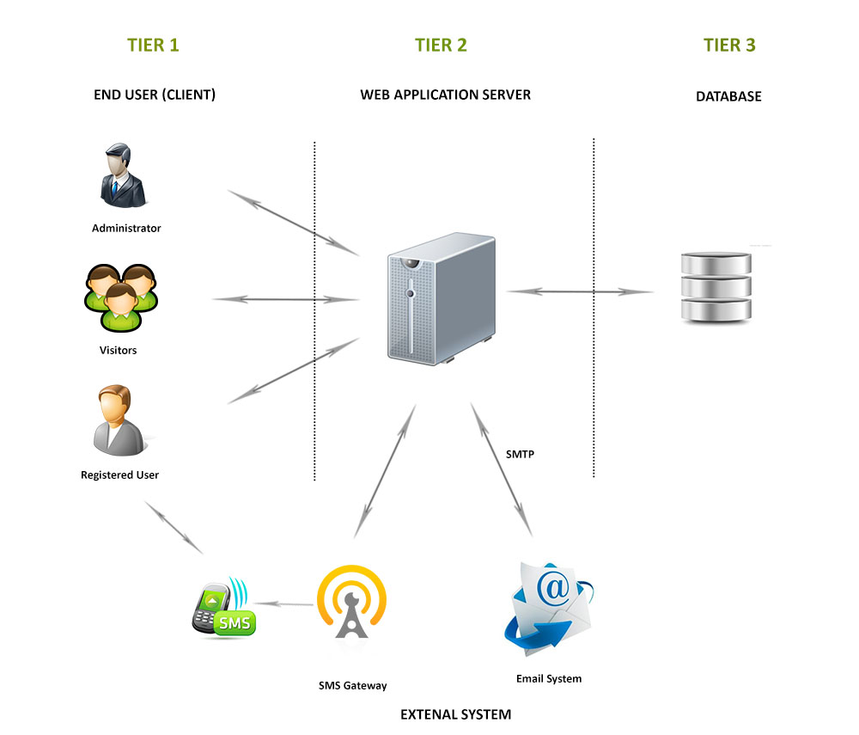
Part 4: Software Design Description
1
Architectural design
FSH

Slide 26
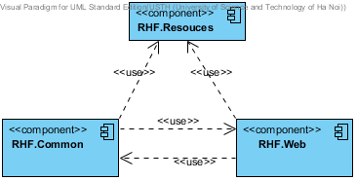
Part 4: Software Design Description
2
Detailed design
Component diagram
FSH

Slide 27
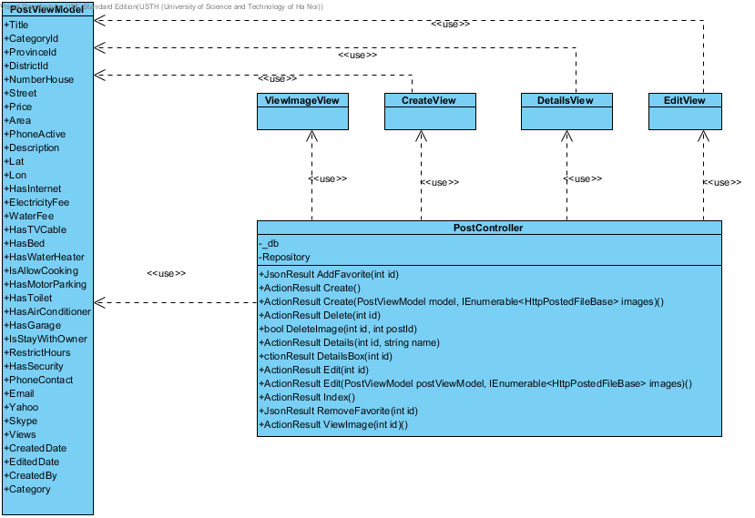
Part 4: Software Design Description
2
Detailed design
PostController-Class diagram
FSH

Slide 28
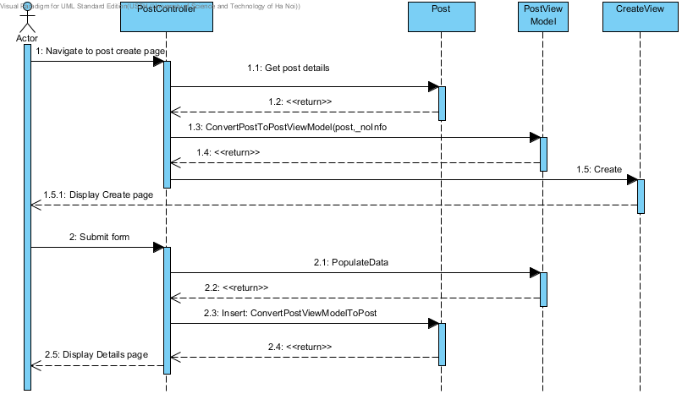
Part 4: Software Design Description
2
Detailed design
CreatePost-Sequence diagram
FSH

Slide 29
Part 4: Software Design Description
3
Database design
3
FSH

Slide 30
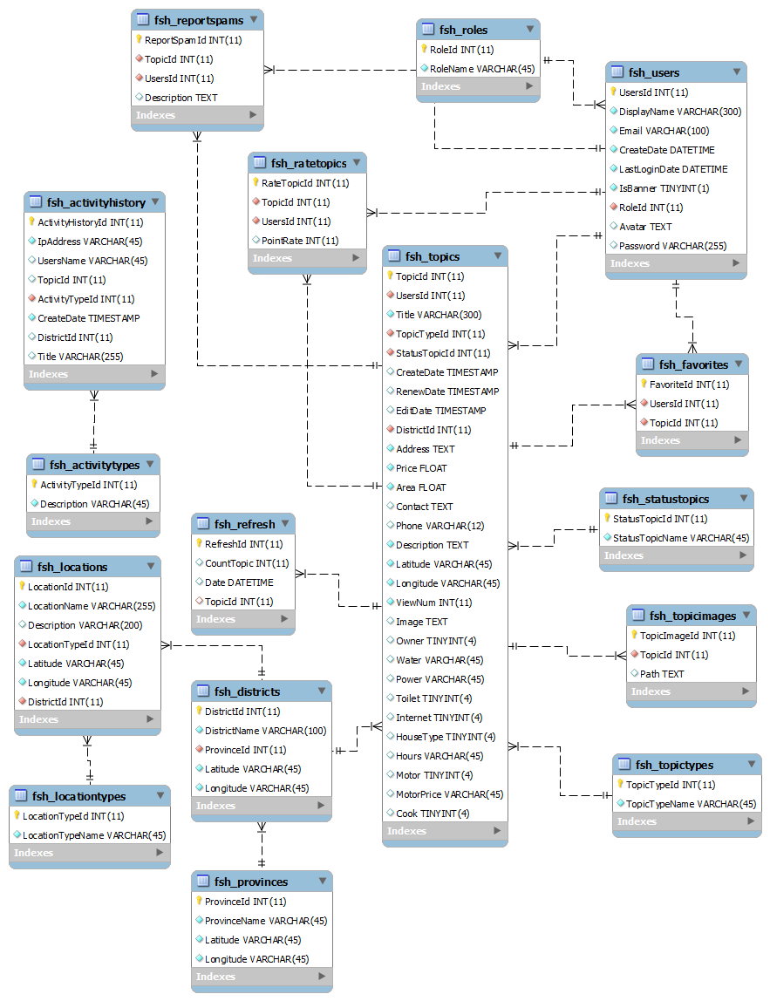

Slide 31
Part 5: Software Test Documentation
1
Unit Testing
2
Integration Testing
3
System Testing
FSH

Slide 32
Test result:
Part 5: Software Test Documentation
Module | Pass | Fail | Untested | Number of Test case
Login-Logout | 12 | 0 | 0 | 12
User manage Owner profile | 8 | 0 | 0 | 8
User manage favorite | 5 | 0 | 0 | 5
View list created topics | 3 | 0 | 0 | 3
View topics detail | 50 | 0 | 0 | 50
Edit topics | 36 | 0 | 0 | 36
Hide topics | 14 | 0 | 0 | 14
Refresh topics | 20 | 0 | 0 | 20
Delete topic | 7 | 0 | 0 | 7
Rate topic | 12 | 0 | 0 | 12
Report topic | 10 | 0 | 0 | 10
Compare topics | 11 | 0 | 0 | 11
Add topic to favorite list | 4 | 0 | 0 | 4
Manage recent topics | 4 | 0 | 0 | 4
Create new/share topic | 44 | 0 | 0 | 44
Search | 16 | 0 | 0 | 16
<Admin> Manage user | 41 | 0 | 0 | 41
<Admin> Manage locations | 12 | 0 | 0 | 12
<Admin> Manage topics | 10 | 0 | 0 | 10
<Admin> Manage report topics | 12 | 0 | 0 | 12
Total | 331 | 0 | 0 | 331
FSH

Slide 33
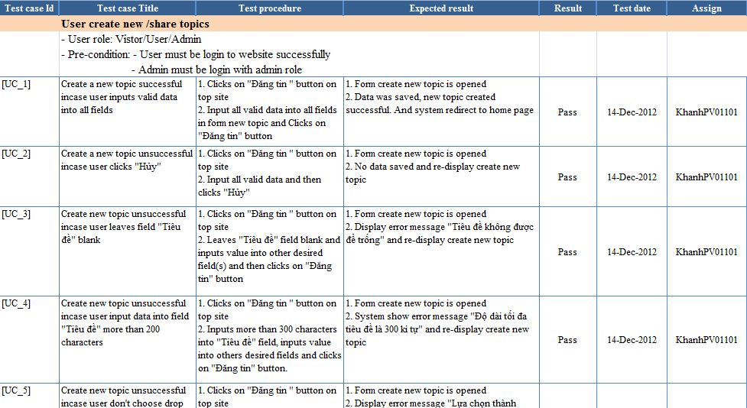
Test Logs
Part 5: Software Test Documentation
FSH

Slide 34
Part 6: Summary
Capstone Project: completed
Future:
Continue developing
Deploy to http://www.5house.us/
FSH

Slide 35
Part 6: Summary
Lesson learnt
Software development process
Team communication
Project management skills
Time management
FSH

Slide 36


Part 7: Demo & Q&A
FSH

Slide 37

FSH

